Slide 1

UMD Alumni Insights Group : Project 0506_07 Date : 12/09/2020

Slide 2
Overview
1

Slide 3
Background
The data was provided by the UMD alumni association and spans 632 rows and 14 columns.
The data consists of 6 numerical columns and 8 qualitative columns.
The data set provided is from 07/01/2013-11/30/2019 and contains seven subsets of data, arranged by fiscal year (July 1-June 30) and outlines each program or event hosted by the Alumni Association and provides general information on the event as well as the event registrants.
The data had predefined identifiers such as location code, activity code and group code
The main target audience of this project is the UMD Alumni Association who would require help in identifying the variables that are correlated to our desired outcomes of higher event attendance for first time attendees and major gift prospect attendees.
Notes:
Data by alumni association in excel format spanning over 7 different sheets.
Combined into 1 sheet and then formed separate sheets based on the pre-defined coding system.
Secondary target audience is the organizing body and the different clubs.

Slide 4
Introduction
Mission statement : To analyze past events for UMD Alumni Association in order to optimize planning and gather insights so that number of first-time attendees and major prospective donors increases.
Mission objectives :
To perform a time trend analysis to analyze on how the number of First Time Attendees and major prospects change over time.
To find the top five locations with maximum number of First Time Attendees and major prospects.
To find the top five Events based on Group Purpose with maximum number of First Time Attendees and major prospects.
To gather insights on how the average age of participants in events co-relates with number of First Time Attendees and major prospects.
To find which Group Audience has the highest number of First Time Attendees and major prospects.

Slide 5
Database Design
2

Slide 6
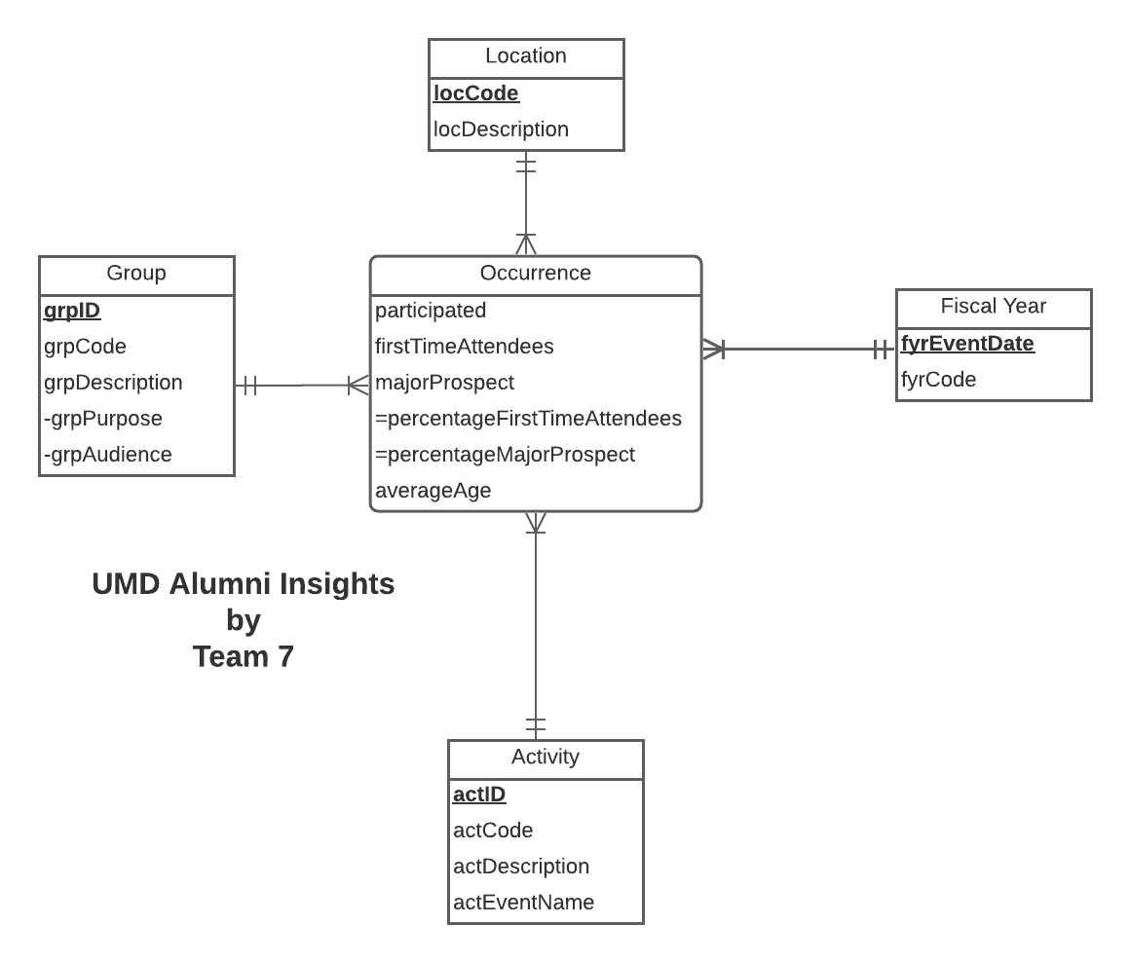
Conceptual Database Design

Slide 7
Logical Database Design
Relational Schema:
Activity (actID, actCode, actDescription, actEventName)
FiscalYear (fyrEventDate, fyrCode)
Location (locCode, locDescription)
Group (grpID ,grpCode, grpPurpose, grpAudience)
Occurrence (actID, locCode, grpID, fyrEventDate, participated, firstTimeAttendees, majorProspect, averageAge)
Notes:
Surrogate keys and the derived attributes.
Group description, split into audience and purpose.

Slide 8
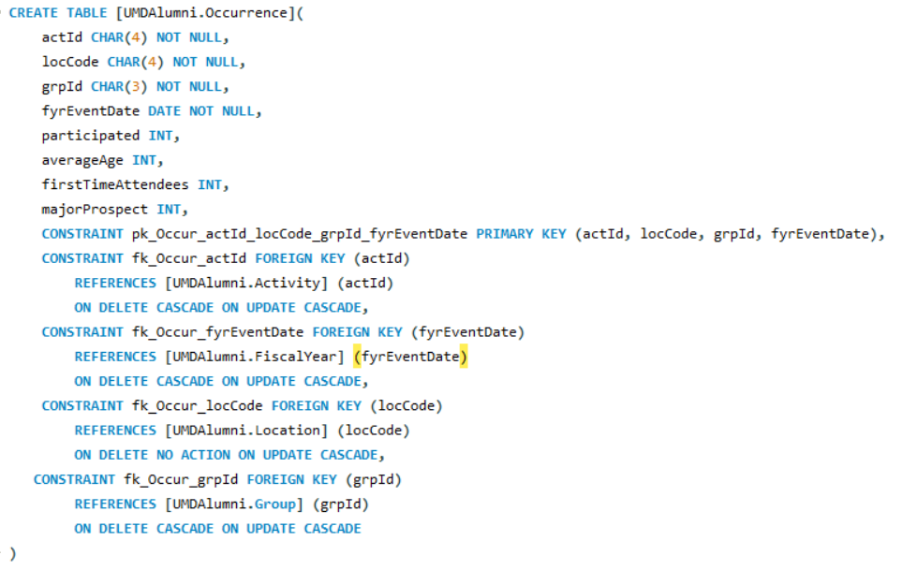
Physical Database Design

Slide 9
Use Cases
3

Slide 10
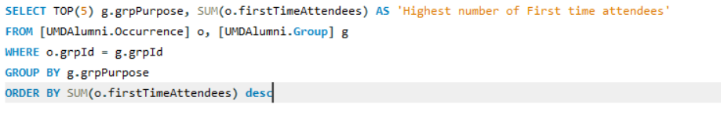
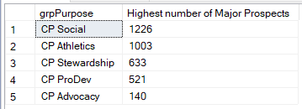
Use Case 1 : Which 5 Group Purposes attract the maximum number of Major Prospects ?
Notes:
Mission Objective 3

Slide 11
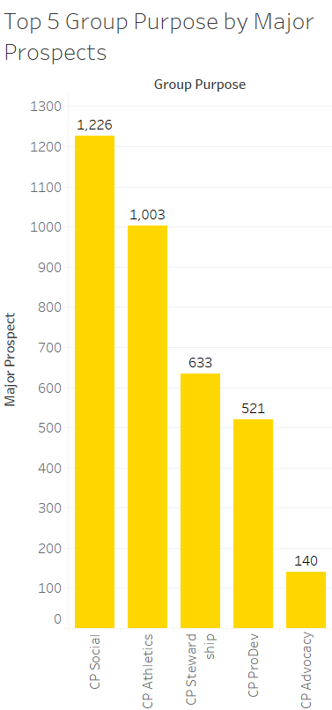
Tableau Output
3

Slide 12
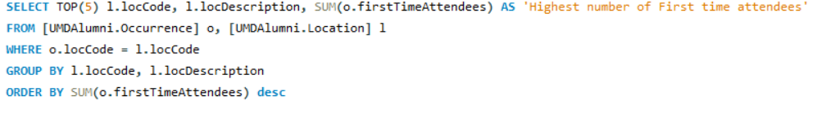
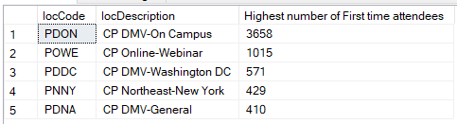
Use Case 2 : What are the top five locations with the highest number of First time attendees?
Notes:
Mission Objective 2

Slide 13
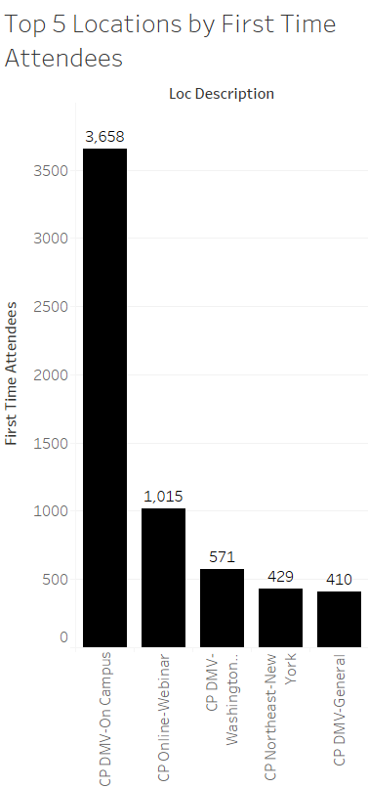
Tableau Output
3

Slide 14
Recommendations
Tableau Dashboard presenting a unified view of the data:
New metric – Event Success. Weighted average of Percentage First Time Attendees and Percentage Major Prospects
Ability to change weight for each metric and filter data by Fiscal Years
View data at different aggregations:
Event : Top N Events based on Event Success
Location: Top 10 Locations vs number of Events
Group: Most successful Event Purpose for top 10 Audiences
Average Age: Average event success by age groups

Slide 15
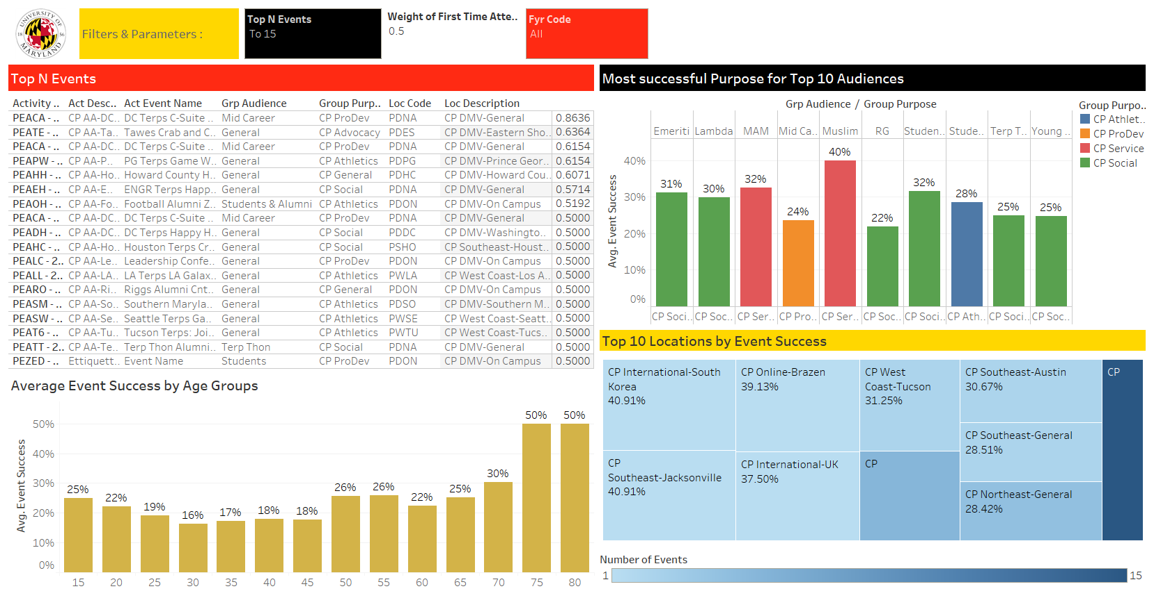

Slide 16
THANKS!
Any questions?

